Slide 1

Excelr Project – 155 Group – 3 Hotel Review – Sentiment Analysis
KIRAN ASHOK KITTUR
UMESH RAJENDRA GADHAVE
ASHLESHA KHANDERKAR
AMAR G. THORAT
PIYUSH BRIJLAL FULZELE
ABHIJEET SANJAY MANE
BABAR BALAJI ASHOK

Slide 2
Business understanding
In the modern day, public discussion and evaluating of products and services occurs beyond dedicated mediums
Online Hotel reviews are currently found on every sites. The majority of reviewers gave a score between 1 and 5, so if a new customer browses online reviews on any of the previously mentioned review sites, they may consider booking a room at the Hotel.
By using sentiment analysis, on existing hotel reviews we have to created a model that can quantify on a scale of 1–5, how the review is good or bad and visitor feels about the hotel also how the visitor think about it. If a review classifies to be less than a score of 3, this could be looked into, find out why they had a negative opinion the hotel, and in return fix the problem.

Slide 3
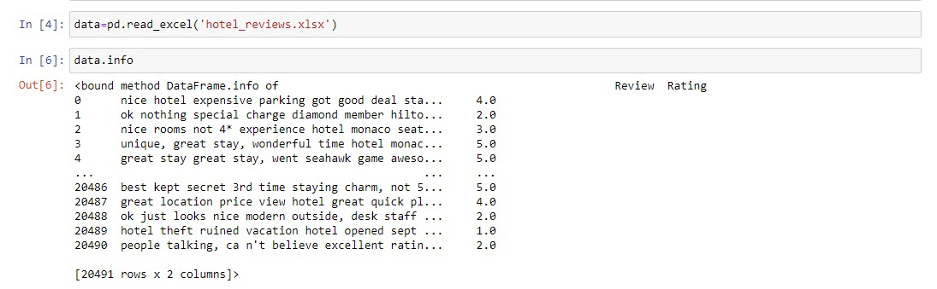
Data Summery

Slide 4
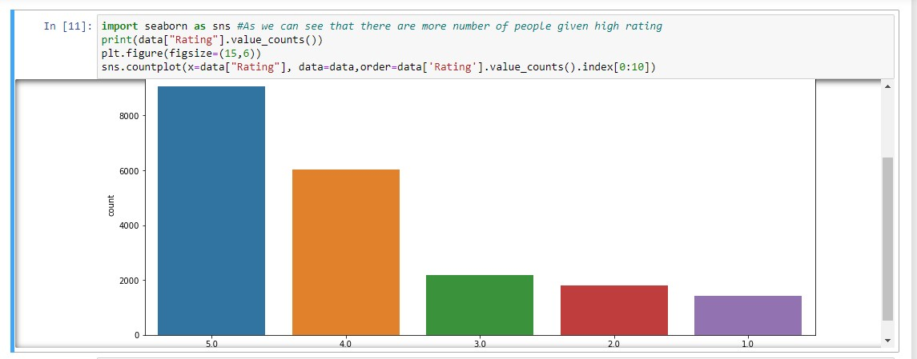
EDA ANALYSIS

Slide 5
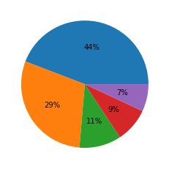
EDA ANALYSIS
We can see that reviews with rating 5 contains 44 % of Total Review
and 29 % contain rating as 4.

Slide 6
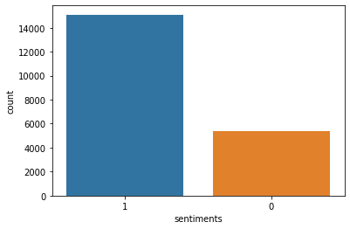
EDA ANALYSIS
We further divide the reviews as positive (1) and negative(0) considering rating greater than 3 to be positive and below that to be negative.

Slide 7
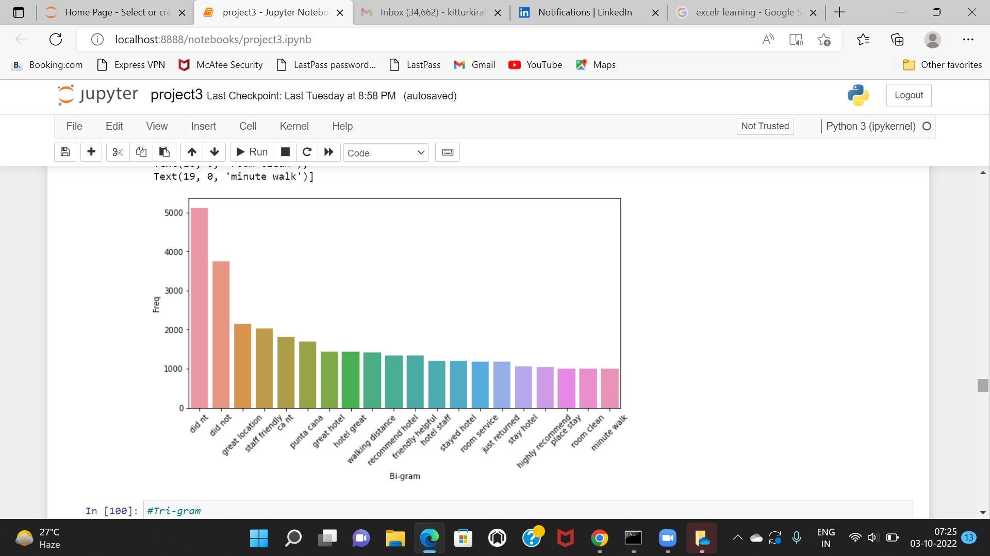
EDA ANALYSIS

Slide 8

EDA ANALYSIS

Slide 9
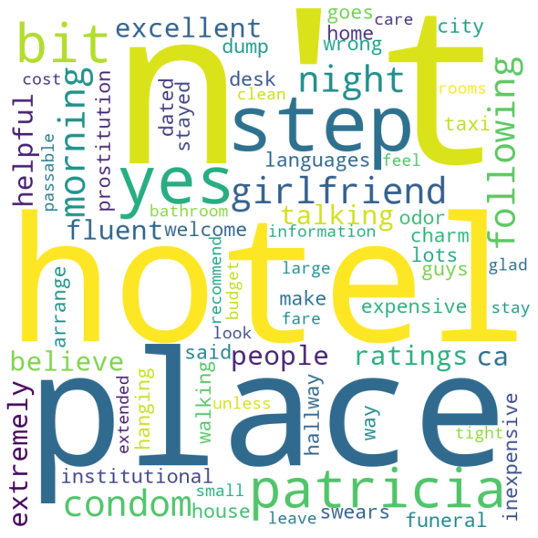
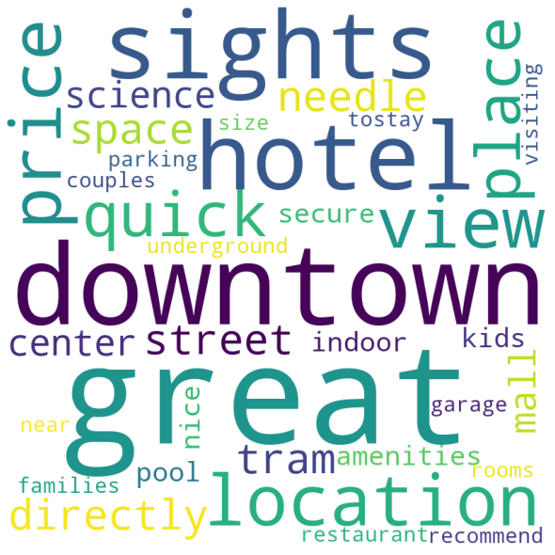
Wordcount
Positive Review Negative Review
Average length of words in positive reviews-695 no and Average length of words in negative reviews-824 no

Slide 10
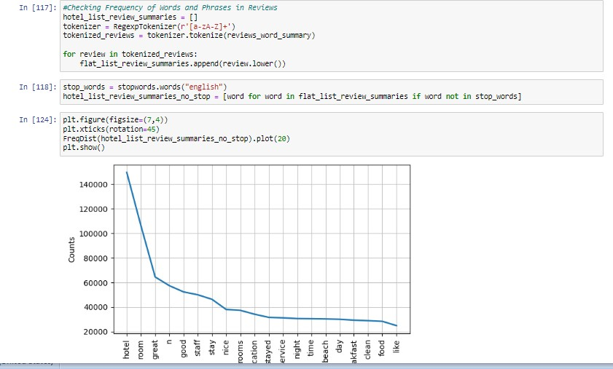
Frequency of words

Slide 11
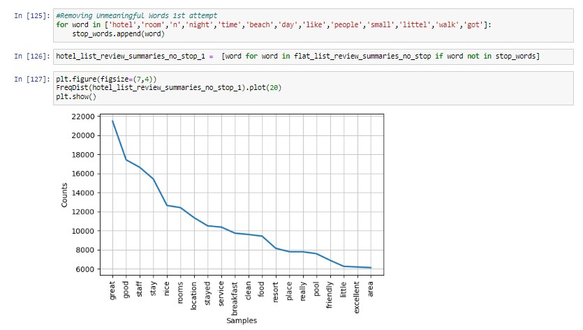
Removing Unmeaningful Words

Slide 12
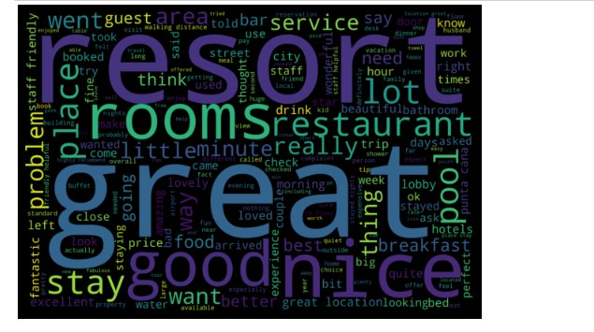
Final Word Count

Slide 13
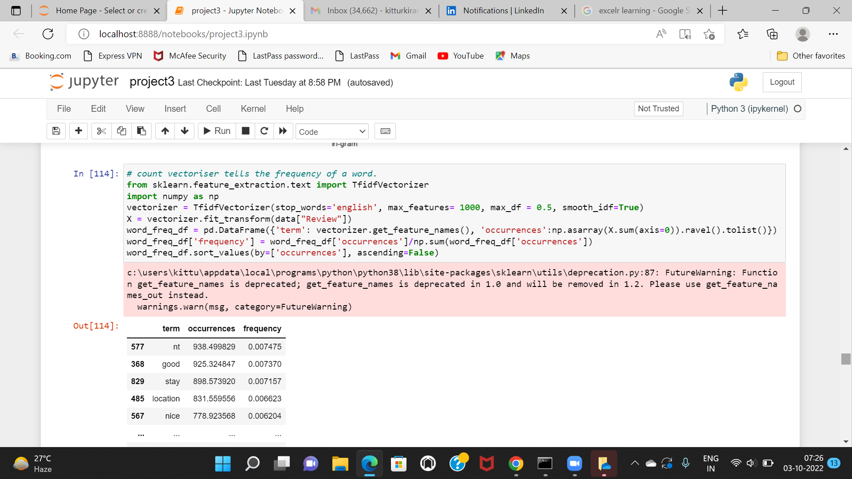
Frequency of words

Slide 14
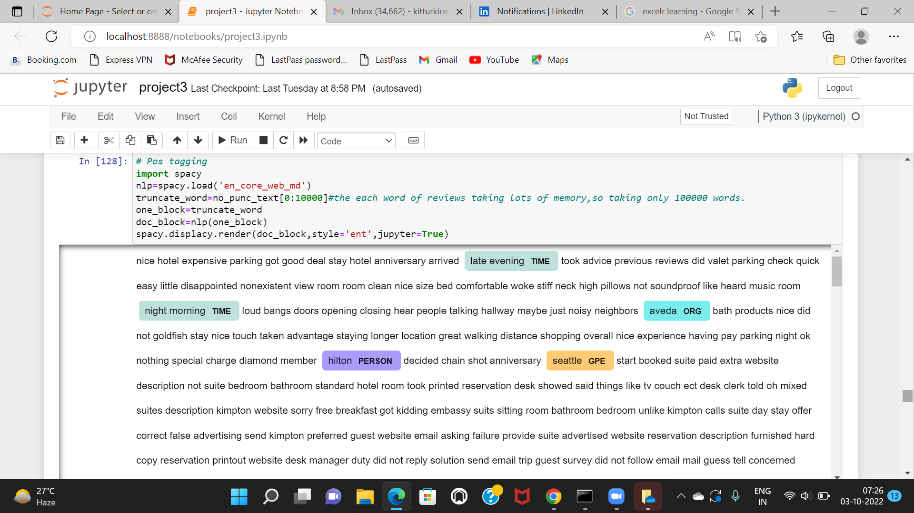
POS Tagging using SpaCY

Slide 15
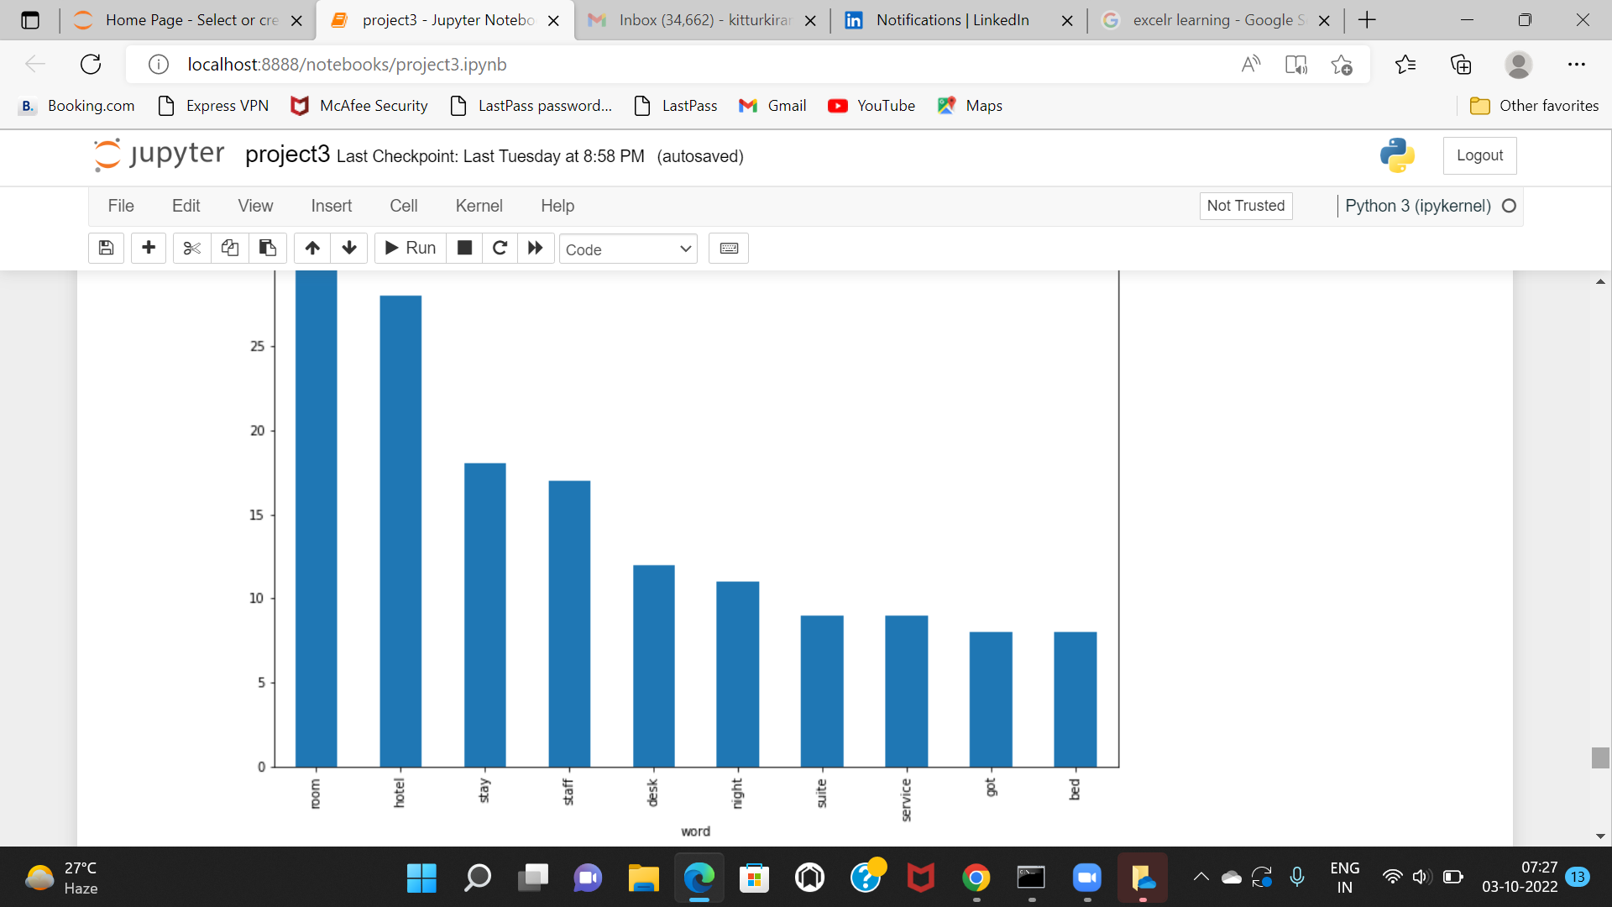
POS Tagging using SpaCY

Slide 16
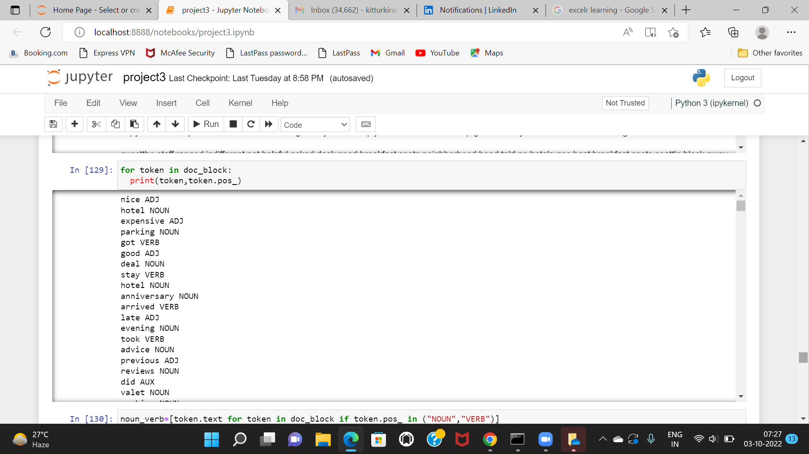
Tokenization

Slide 17
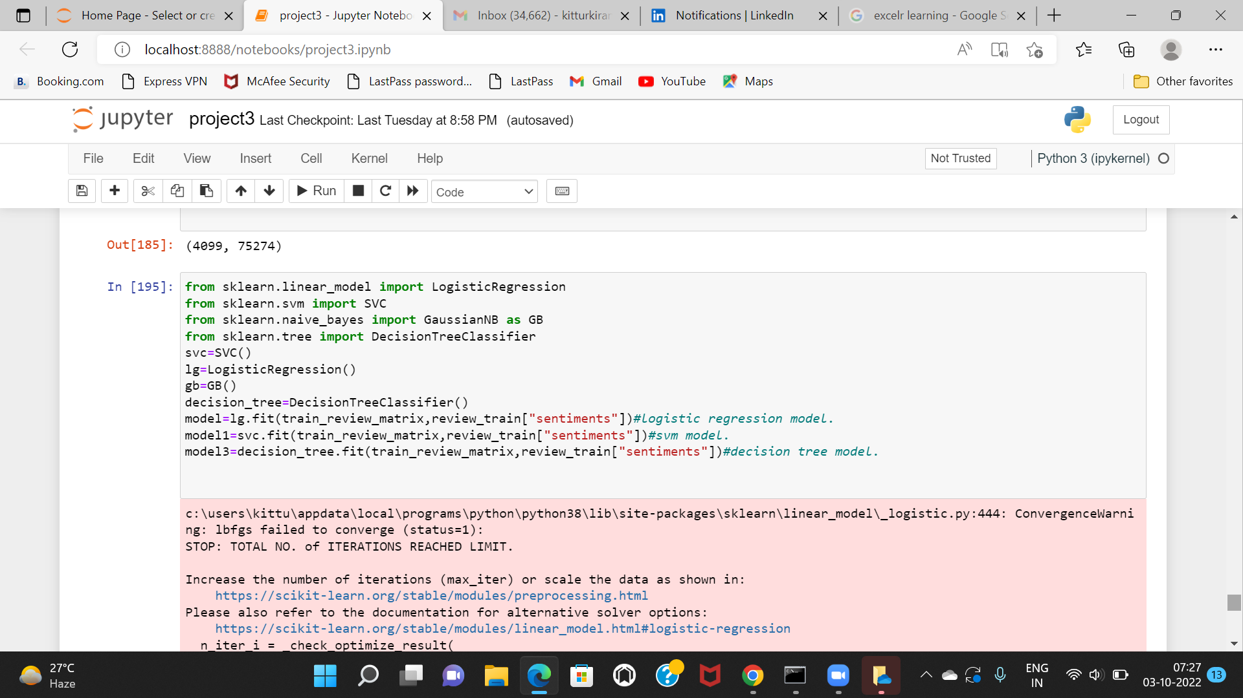
Testing using different Algorithms
(svm, Decisiontree and Logistic Regression)

Slide 18
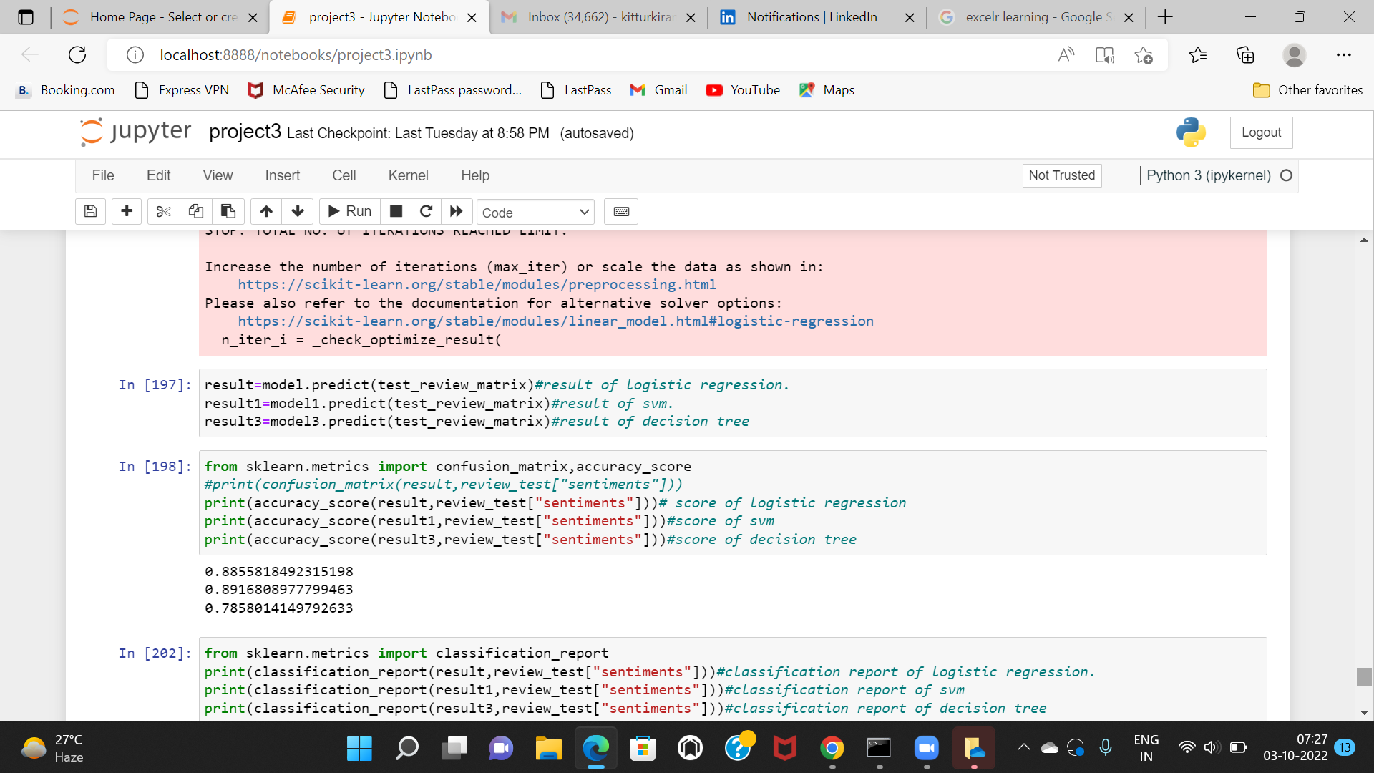
Testing using different Algorithms

Slide 19
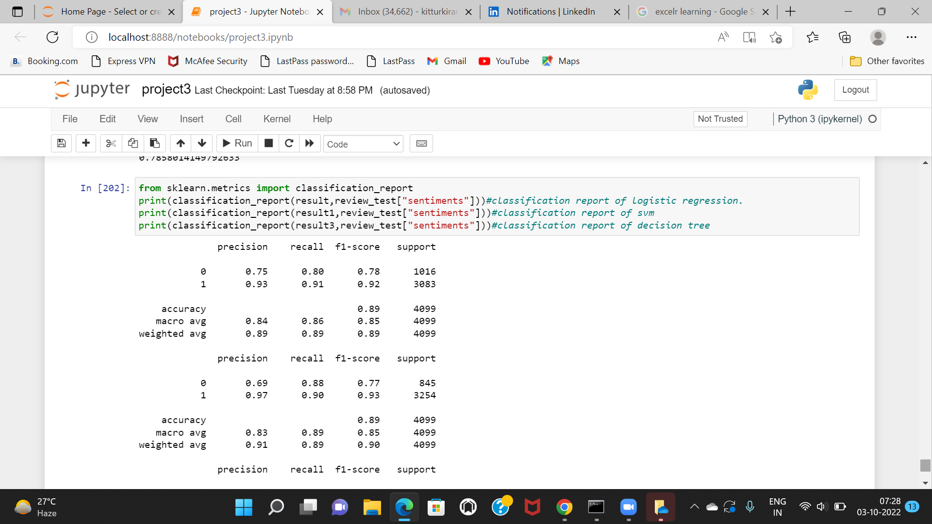
Classification Report

Slide 20
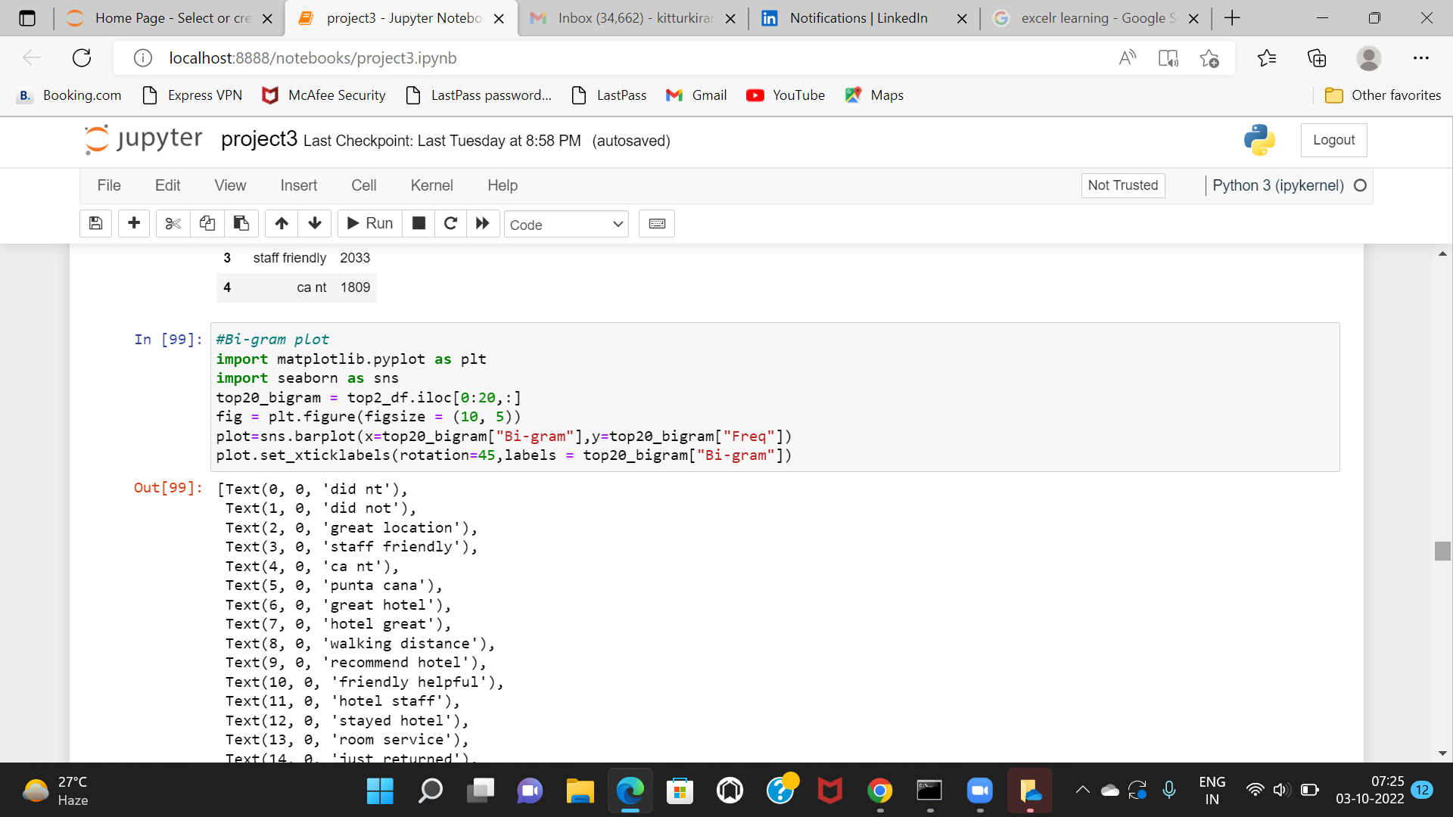

Slide 21
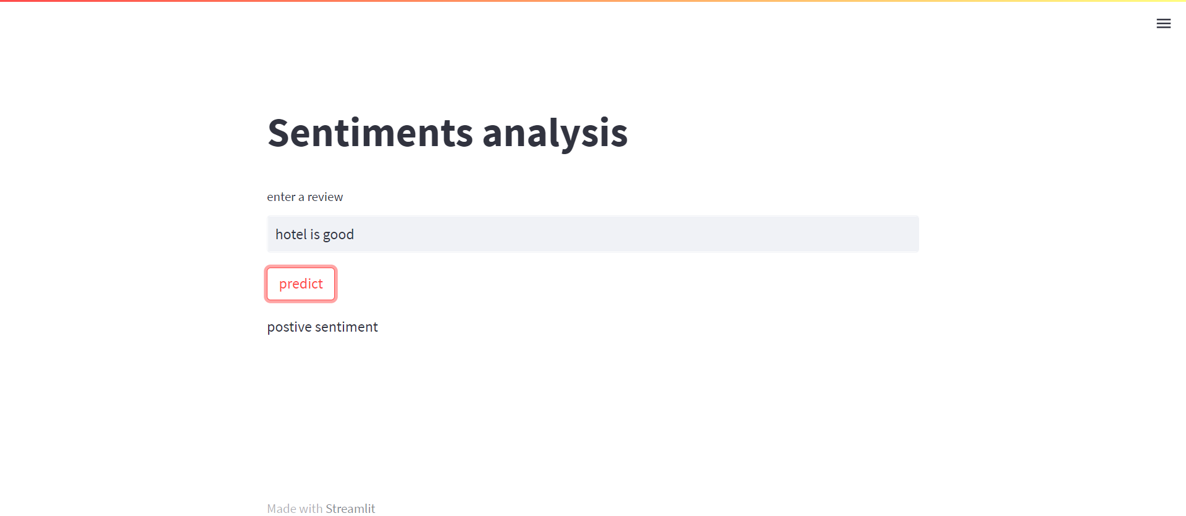
Deployment by using streamlit
Network URL: http://192.168.43.88:8501

Slide 22
Thank you

